Slide 1
MY SCHOOL

Slide 2
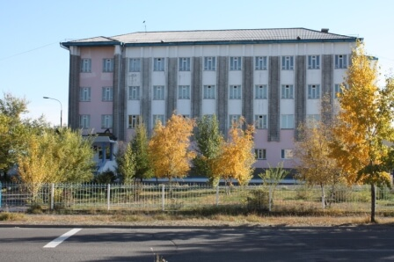

Slide 3
HI

Slide 4
OUR CLASSROOM

Slide 5
OUR PROFILE

Slide 6
DECORATION

Slide 7
STAIRS TO 2nd FLOOR

Slide 8
HALL

Slide 9
WATER DISPENSER

Slide 10
OUR GRADUATES

Slide 11
English Classroom

