Slide 1
Hello! I’m Belek.

Slide 2
I’m from Russia. I can speak Russian and Tuvan. I study English at school. I can’t speak French.

Slide 3
There are a lot fof diferent nationalities live in Russia. I’m rom Republic of Tuva. I’m Tuvan.

Slide 4
Kyzyl is the capital of Tuva.

Slide 5
I live in Kyzyl. It is a small, but a very beautiful and interesting capital. Kyzyl is in the geographical centre of Asia.

Slide 6
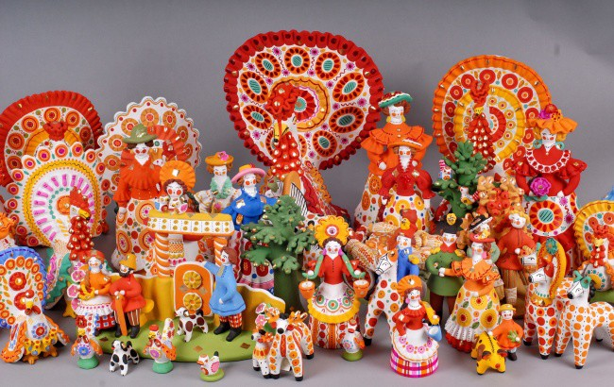
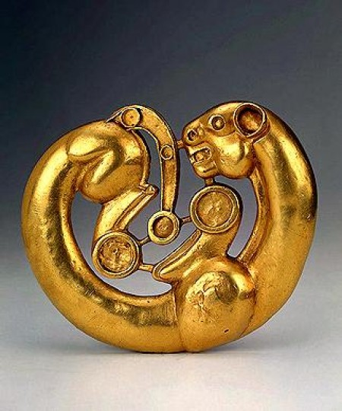
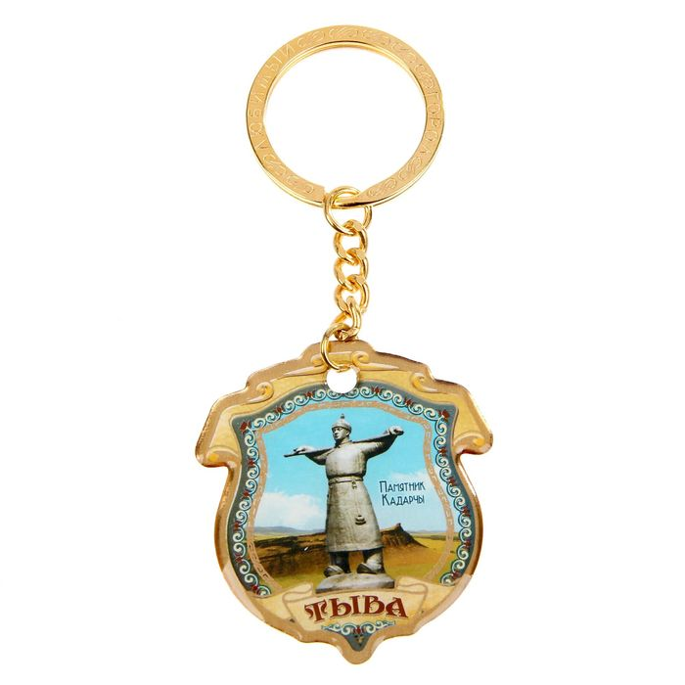
Souvenirs from tuva

Slide 7
Tuvan masters make souvenirs of various materials. These souvenirs are made of felt.

Slide 8
These are tuvan national pillows. You can buy these in the souvenir shop at the National museum or «Olchey» shop.

Slide 9
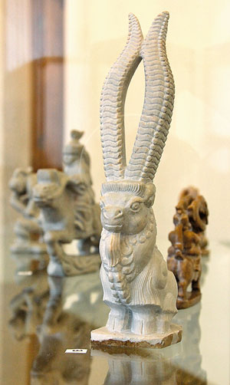
These souvenirs are made of agalmatolite stone. You can see and buy them in the “Shever” shop or “Olchey” shop in Kyzyl.

